Slide 1

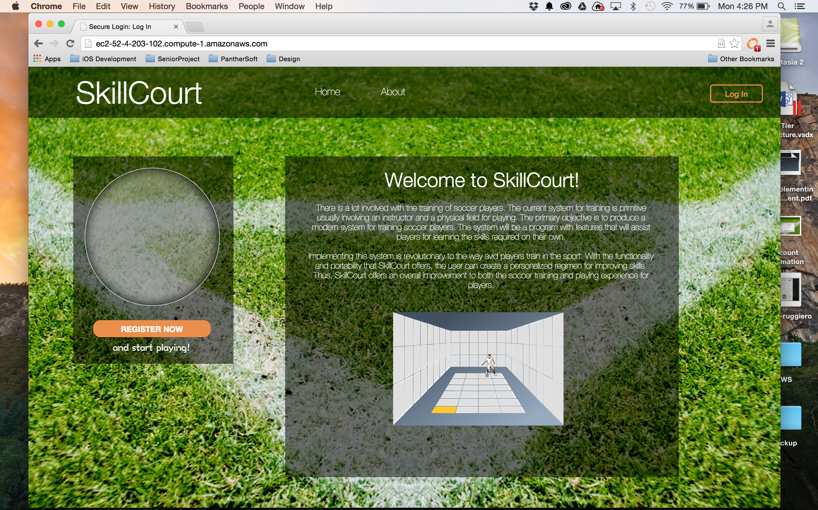
^{Introducing}
SkillCourt v2
Product Owners:
Mentor:
Team Members:
Gummi Traustason & Jaime Borras
Erico Oyarzun & Andres Ruggiero
Masoud Sadjadi
Notes:
Hello everyone
Welcome to the senior project showcase. My senior project is SkillCourt and my mentors are gummi traustason and jaime borras and as developers we have erico oyarzun and myself, andres ruggiero.

Slide 2
Problem
Skillcourt
Team focused sport.
One coach per team.
Lack of individual supervision.
Infrastructure requirements.
Notes:
While many areas have integrated technological advances properly, others like sports lack the ability to assimilate technology with traditional techniques. This problem is focused to one sport, soccer.
It is a team-focused sport that has only one coach dedicated to the entire team, and the problem arises when players want to train & improve individual weaknesses. Moreover, the infrastructure requirements are very expensive because the need for a physical field.

Slide 3
Current system
Skillcourt
Limitations
Arduino Micro-controller
Mobile Application
Desktop Simulator
Notes:
SkillCourt offers a solution that allows players to have a one-to-one interaction with the system, providing the ability to perform different routines to target personal weaknesses. The concept constitutes of a SkillCourt room filled with SkillCourt pads. Those pads illuminate with different colors, and are used to provide guidance to the player on how to move or what targets to hit.
The limitations of the current system is that it requires the combination of an Arduino Micro-controller, a mobile application and a desktop simulator. This significantly reduces the target audience.

Slide 4
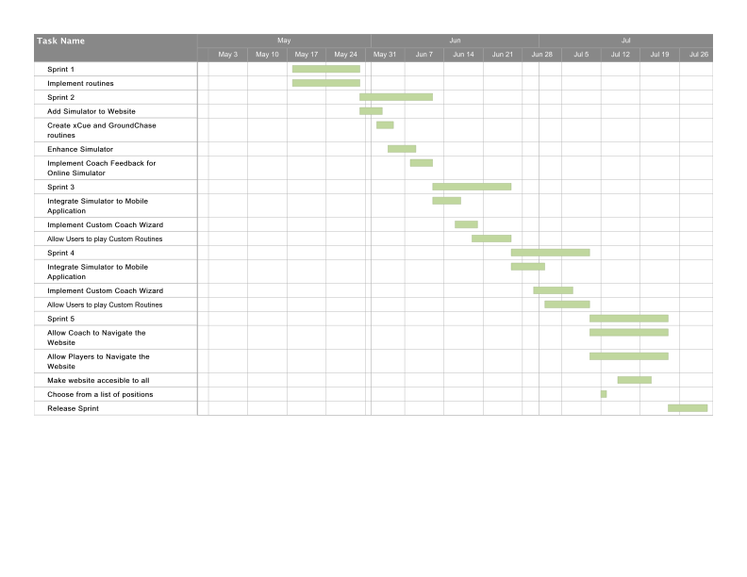
Project Management
Skillcourt
Notes:
Agile Scrum was used as a development methodology. As you can see in the Gantt Chart, the project was divided into 5 two-week development sprints and a final Release Sprint to prepare the product showcase.
Before each sprint, the team went through a sprint planning, to decide what user stories are going to be developed. A sprint review was done after each development sprint, followed by a sprint retrospective with the team members.

Slide 5
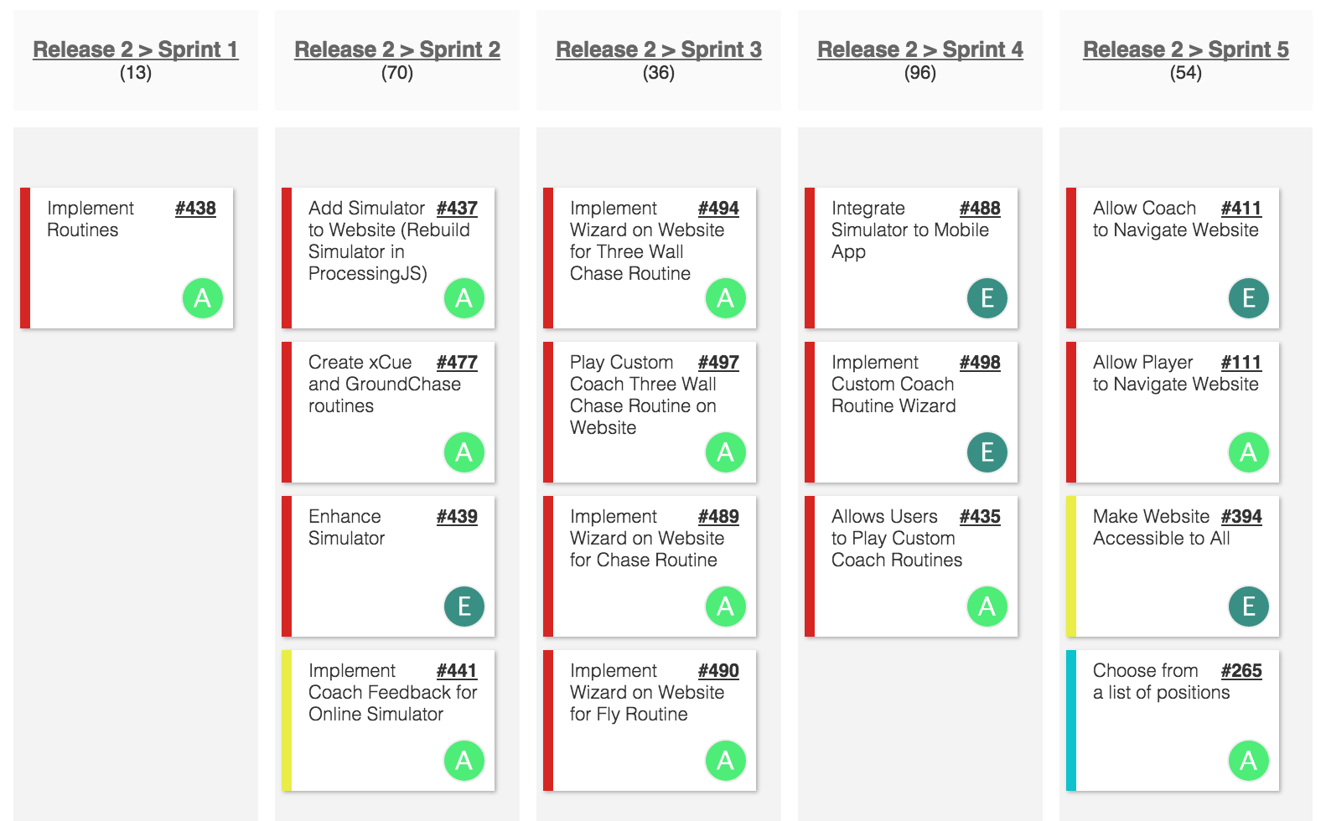
USer Stories
Skillcourt
Notes:
Agile Scrum was used as a development methodology. As you can see in the Gantt Chart, the project was divided into 5 two-week development sprints and a final Release Sprint to prepare the product showcase.
Before each sprint, the team went through a sprint planning, to decide what user stories are going to be developed. A sprint review was done after each development sprint, followed by a sprint retrospective with the team members.

Slide 6
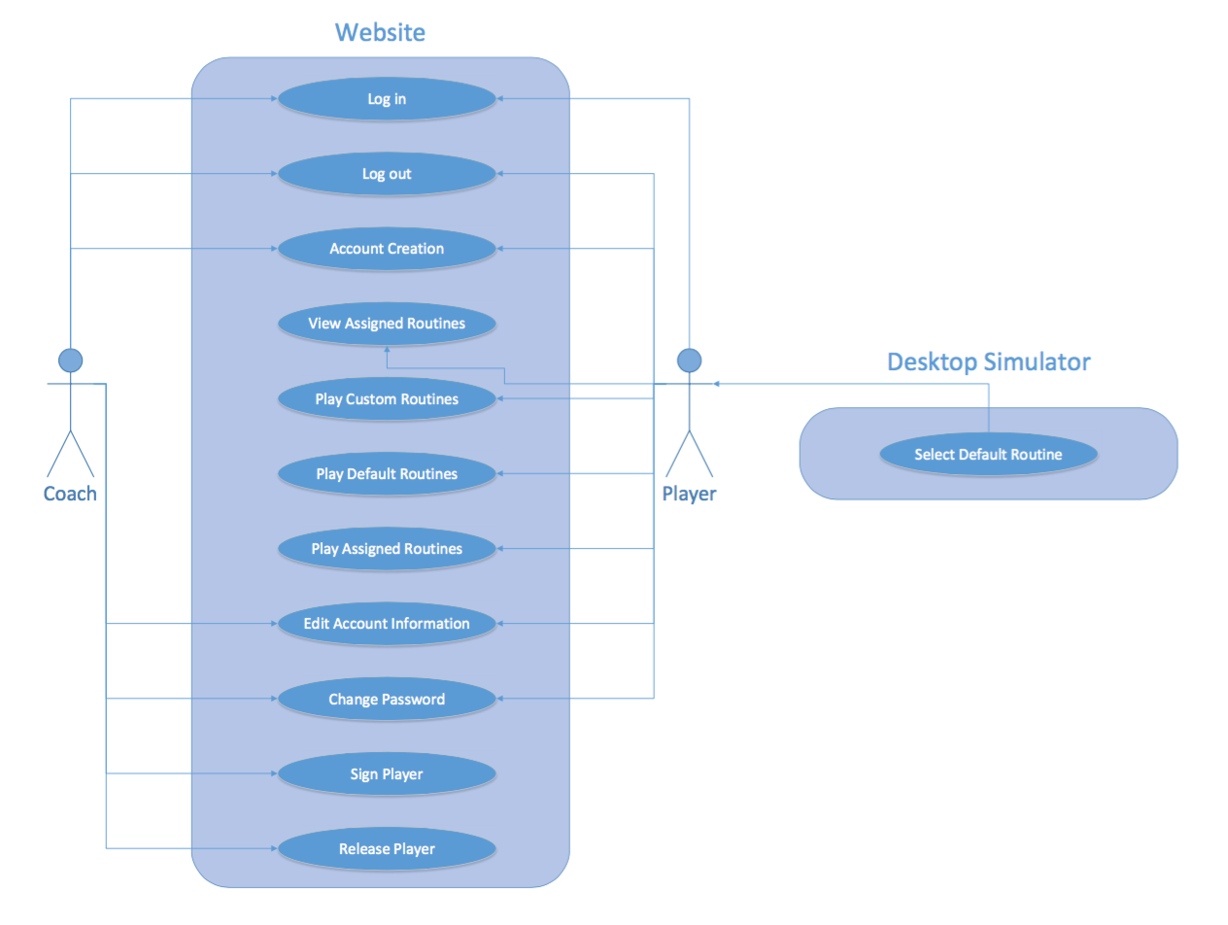
Use Case Diagram
Skillcourt
Notes:
This is the use Case Diagram for the system, which reflects my implemented user stories as well. As you can see, my contribution was more focused on adding new features to the website, like developing the online simulator and implementing player functionalities to the website.

Slide 7
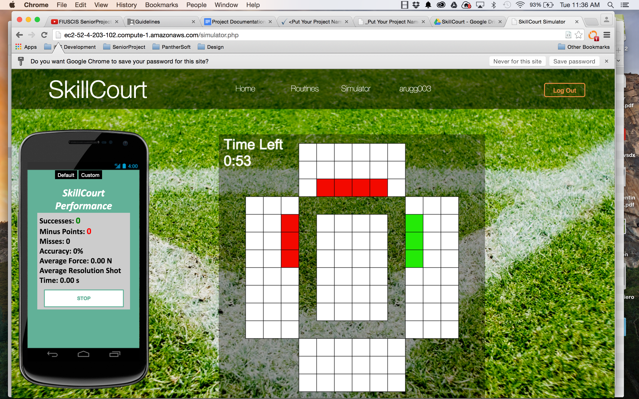

Implemented Use Cases
Skillcourt
Play Custom Routines
Simulator
Notes:
Play custom routines is one of the most important use cases, because it includes the implementation of the online simulator on the website.
The online simulator was built using Processing.js. After the Processing Sketch was implemented, it was mounted on the website using JavaScript. This allows the user to play a custom and default routine on the website.

Slide 8
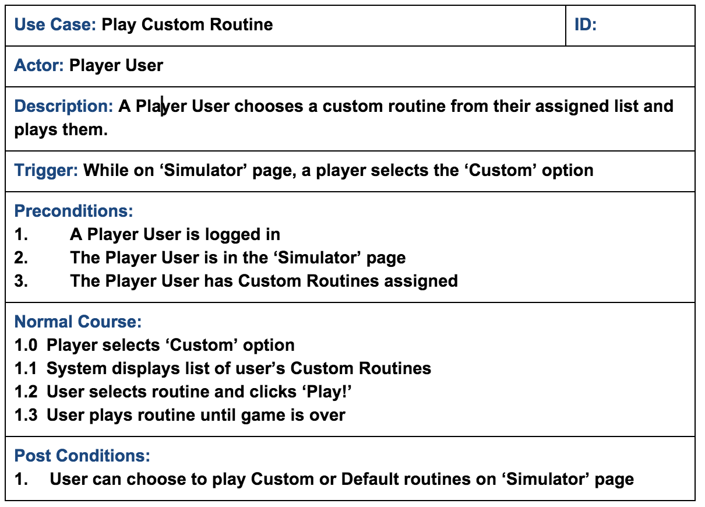
Use Case
Skillcourt
Notes:
As you can see the actor for these use case is a player and the requirement is that he has to be logged in to the system, custom routines must assigned to him and the player must be in the ‘Simulator’ Page on the website.
First, the player selects the ‘Custom’ option. Then the player must select a custom routine form the dropdown menu, and finally clicks play to start the routine

Slide 9
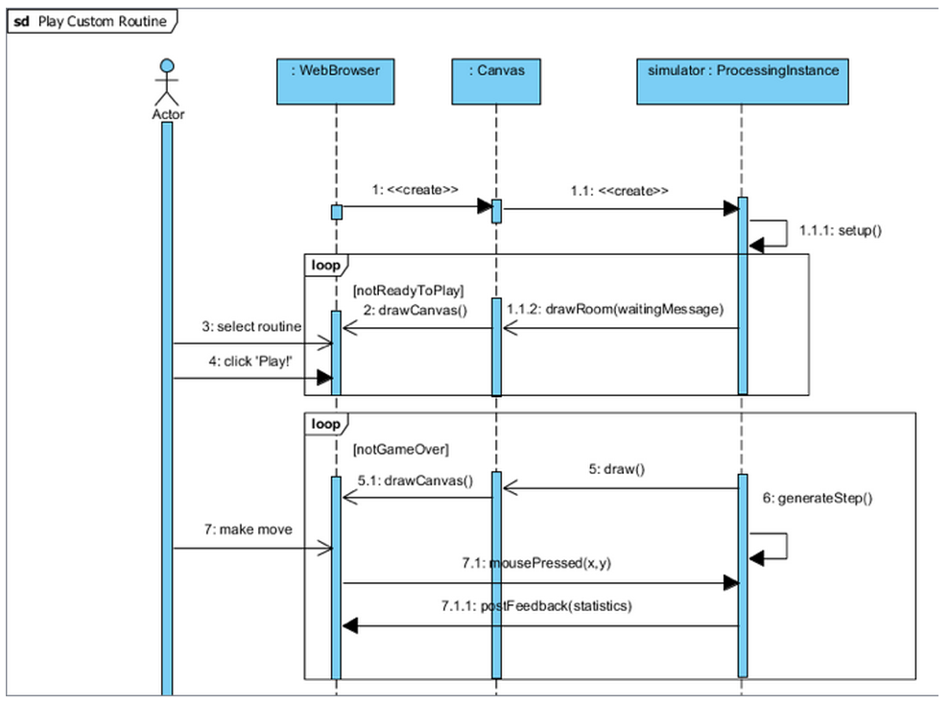
Sequence diagram
Skillcourt
Notes:
This is the sequence diagram for the Play Custom Routine use case. As you can see the user will select the routine and click play. Then the processing instance will start a loop to draw the simulator on the website, and wait for incoming moves from the player until the game is not over.

Slide 10
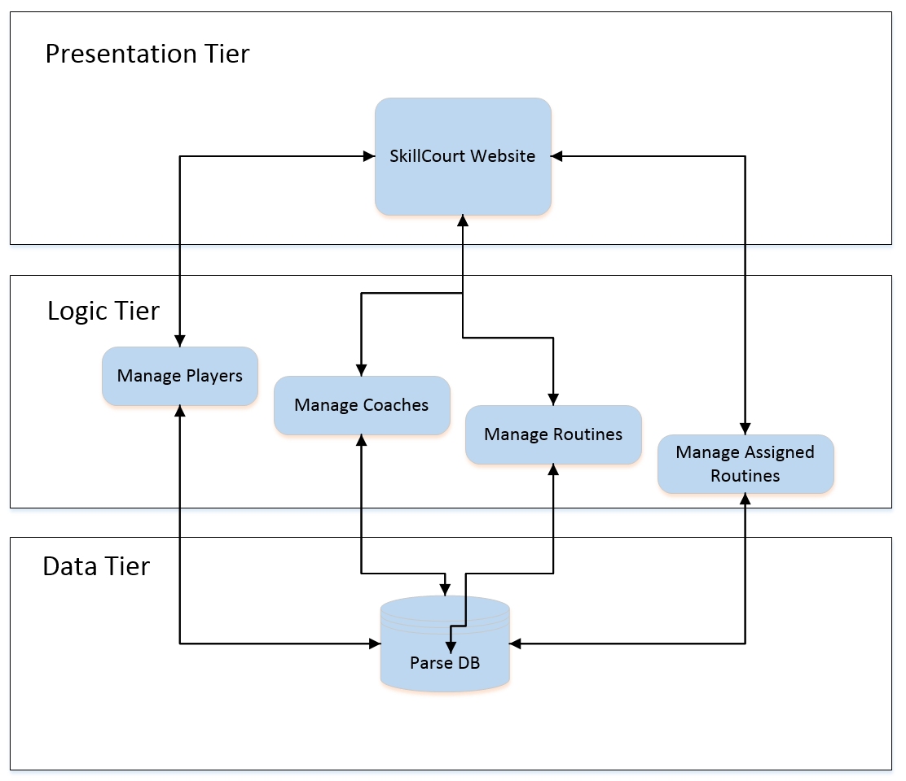
System Design
Skillcourt
3 - Tier Architecture
Notes:
The design patterns used in the project are the 3 tier Architecture. The three tier architecture was selectedto provide independency between the User Interface, the logic processing and the data model.

Slide 11
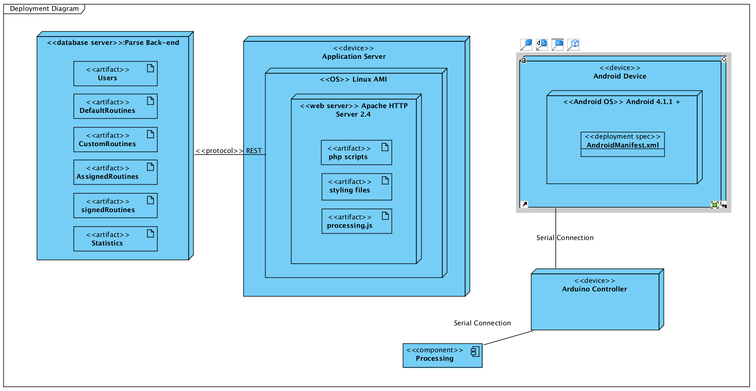
System deployment
Skillcourt
Notes:
As hardware requirements, an android device with bluetooth capabilities is required, as well as an arduino micro-controller.
As for software requirements, we used processing.js to develop the online version of the simulator. PHP Javascript query html and css to develop the website. Parse as a backend solution , and Android Studio to enhance the mobile application. and finally Amazon Web Services was used to host the website.

Slide 12
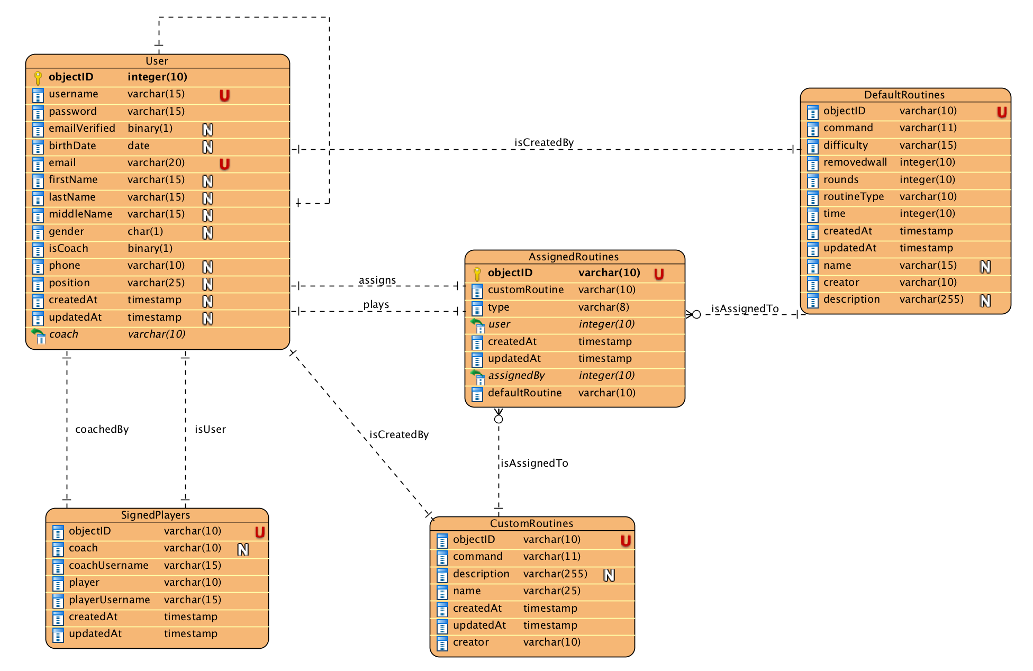
Persistent Data Design
Skillcourt
Notes:
As a back-end solution, we used Parse. This is the diagram that shows what our database is composed of. As you can see we have users, that can be both coaches or players, we also store default and custom routines. We keep track of what players are signed to what coach, and what routines do each player has been assigned.

Slide 13

Security and Privacy
Skillcourt
Encryption protocols over
sensitive data
Session Management
Notes:
One of the reasons that Parse was selected as a back-end solution, is because it provides services such as data encryption and session management. this implies that sensitive information is being securely encrypted and transmitted throughout the network, and session management prevents users to view undesired information.

Slide 14
Class Diagram
Skillcourt
Notes:
This is the Class diagram for the online simulator on the website. The most important concept to remark is that the simulator has the ability to play both custom and default game types. This was performed by implementing object oriented design principles and the use of an GameInterface, that allows both game types to be played.
This also introduces the next slide, that talks about the very important algorithm used in the system.

Slide 15
Main Algorithm
Skillcourt
Maste
Master Game
Maste
Game Interface
Maste
Maste
Custom Game
Game
Notes:
The main algorithm of the simulator is based on object oriented design principles. The processing sketch instantiates a Master Game class. The Master game class contains a game interface, which allows custom games or default games to be played. The Custom Game and Game classes implement the Game Interface.
After the game starts, and the processing sketch has instantiated the objects, it enters into a loop. This loop draws the simulator, and waits for the user to make a move. Then the corresponding game handles the input and processes it. After the game is finished, the loop is ended and the processing instance is terminated.

Slide 16
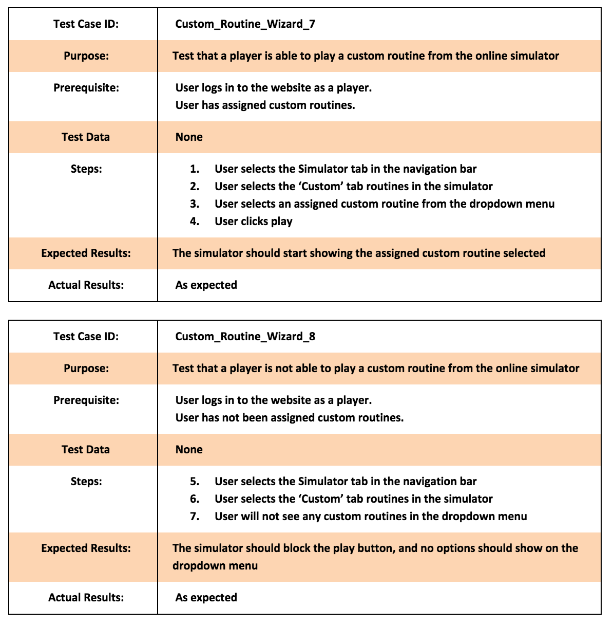
Test Cases
Skillcourt
Sunny Day
Rainy Day
Notes:
After Implementing the system, one of the most important components to test was the Play Custom Routine use case. First we must ensure that a player could play a custom routine. As a prerequisite the user has to be logged in as a player, and a custom routine must have been assigned previously. The results were as expected and the user can play the routine
Another important test case was to make sure that a player with no assigned routines wouldn’t be able to start an empty simulator. As a prerequisite a user must be logged in as a player, and no custom routines should have been assigned. The results are as expected; the system blocks the play button and no routines show in the dropdown menu.

Slide 17
Thank you
for your attention

